Slide 1
PoC - Building a Serverless Web App on AWS Services
By: Pradeep Kumar Gupta
Aug 2019

Slide 2
PoC Objective
Building a simple web application using the following AWS Services:
AWS DynamoDB as the database
AWS Lambda to create functions that will read and write from/to the database
AWS API Gateway to create the REST API that the web application will use
AWS S3 to host the web application
AWS CloudFront to deliver the web application from a location near to the user's location.

Slide 3
Architecture

Slide 4
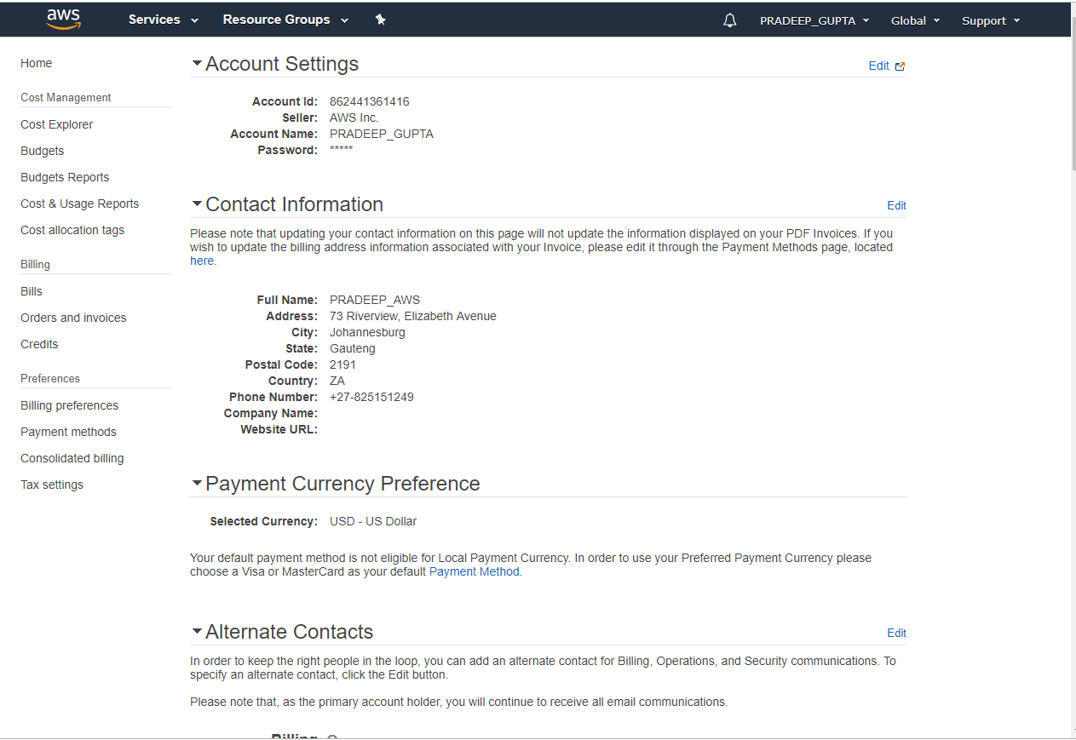
Amazon Login Credential
All Development has been done using my AWS Account PRADEEP_GUPTA as below

Slide 5
Development Approach
1
Creating Dynamo DB Data Structure
2
Creating Lambda Function
3
Setting API Gateway
4
Creating the App
5
Hosting the App in S3
6
Testing the webapp

Slide 6
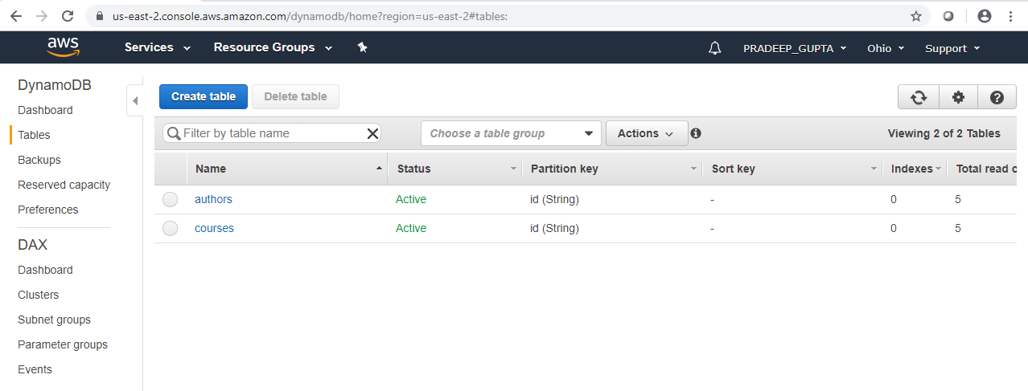
1. Create Dynamo DB Data Structure
ARN:
arn:aws:dynamodb:us-east-2:862441361416:table/courses
arn:aws:dynamodb:us-east-2:862441361416:table/authors

Slide 7
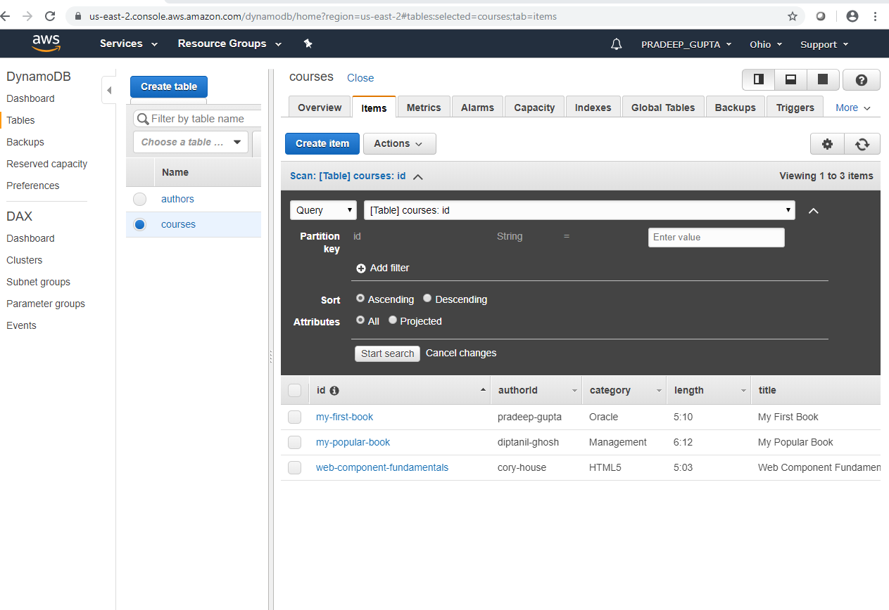
1. Create Dynamo DB Data Structure

Slide 8
2. Creating Lambda Function
Following Lambda Function has been created using Node.js 10.x
1. get-all-authors to return all the users in the database
2. get-all-courses to return all the courses in the database
3. get-course to return only one course
4. save-course to create a new course
5. update-course to update a course
6. delete-course to delete a course
Runtime: Node.js 10.x
Node - Please see .js file for the functions.

Slide 9
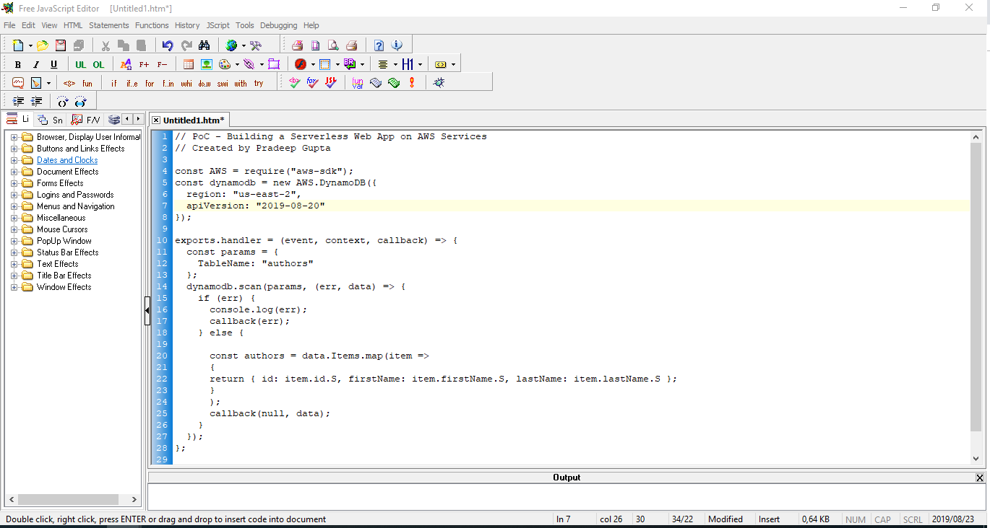
2. Creating Lambda Function - get-all-authors

Slide 10
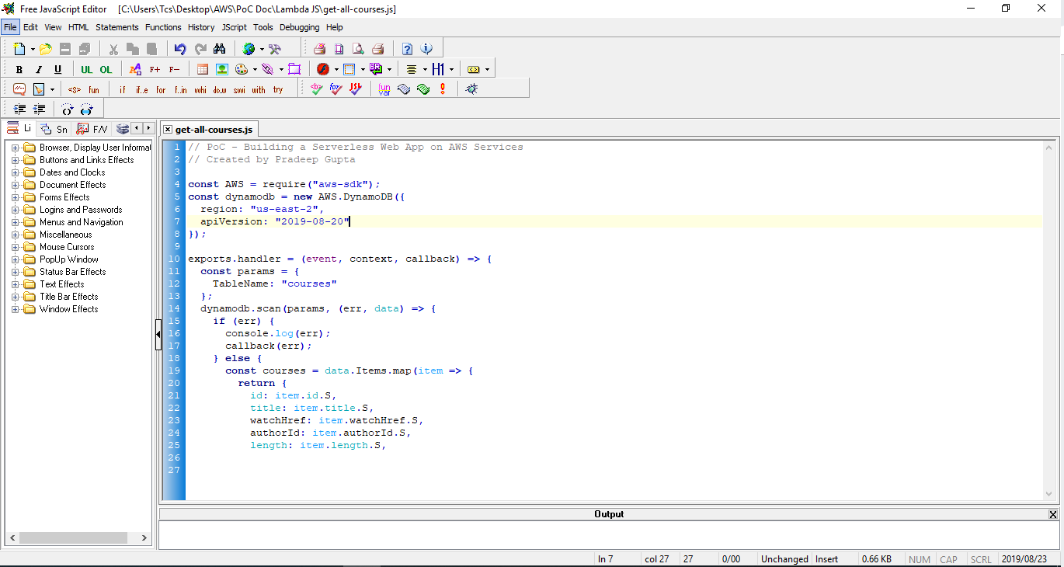
2. Creating Lambda Function - get-all-courses

Slide 11
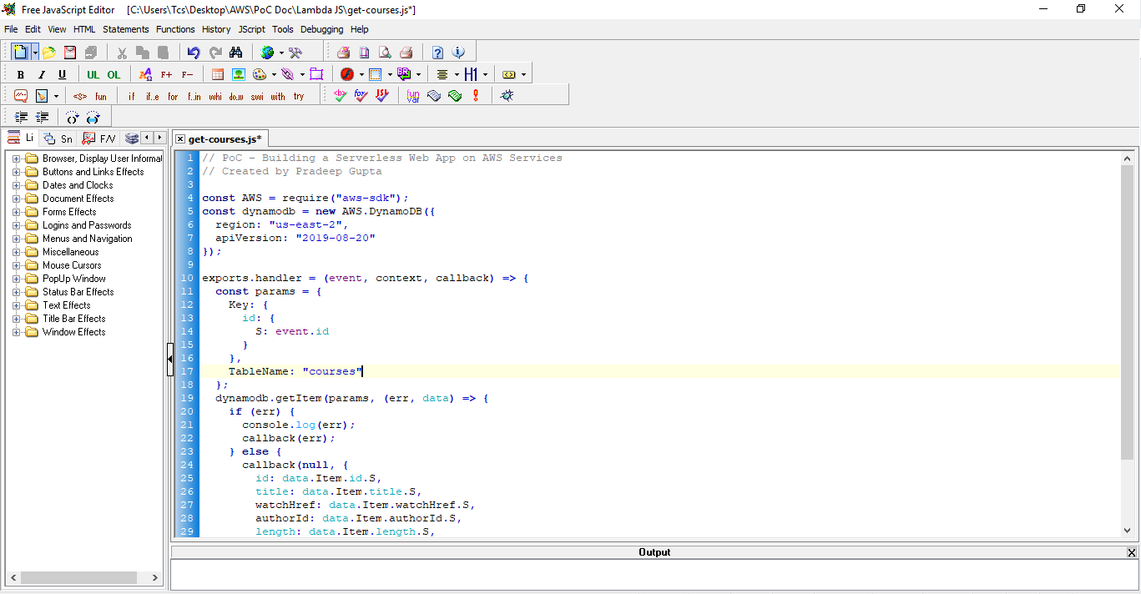
2. Creating Lambda Function - get-course

Slide 12
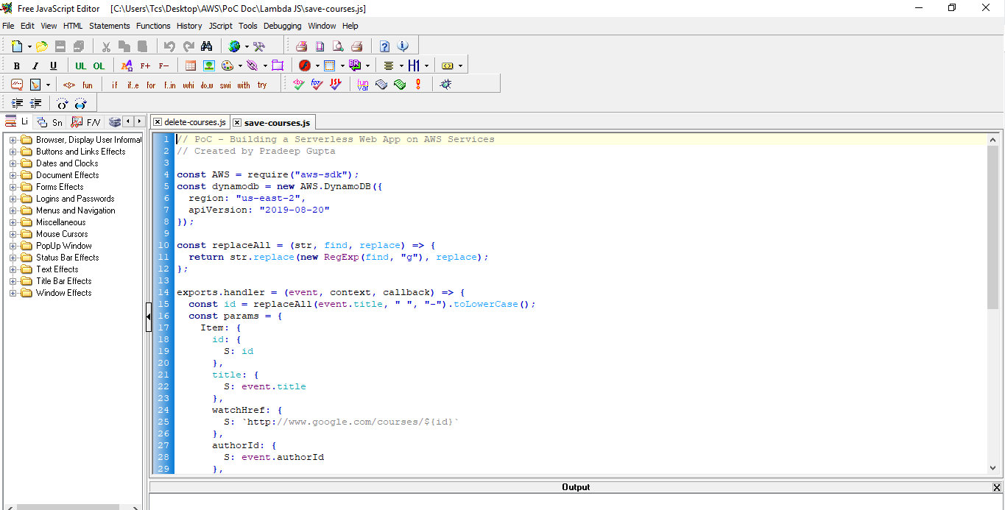
2. Creating Lambda Function - save-course

Slide 13
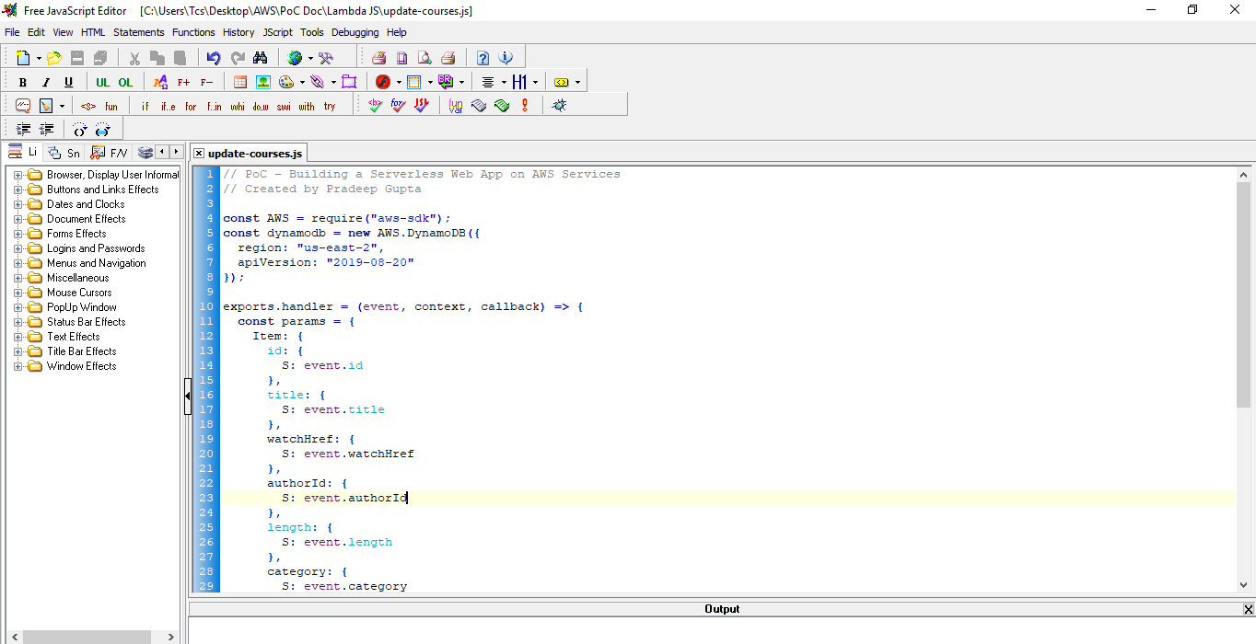
2. Creating Lambda Function - update-course

Slide 14
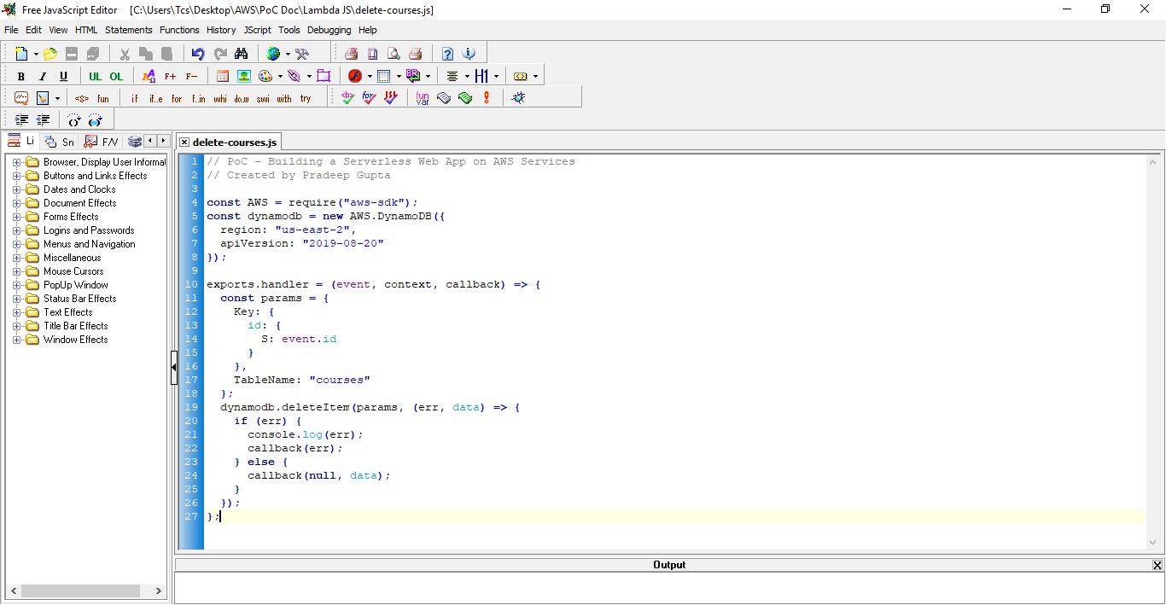
2. Creating Lambda Function - delete-course

Slide 15
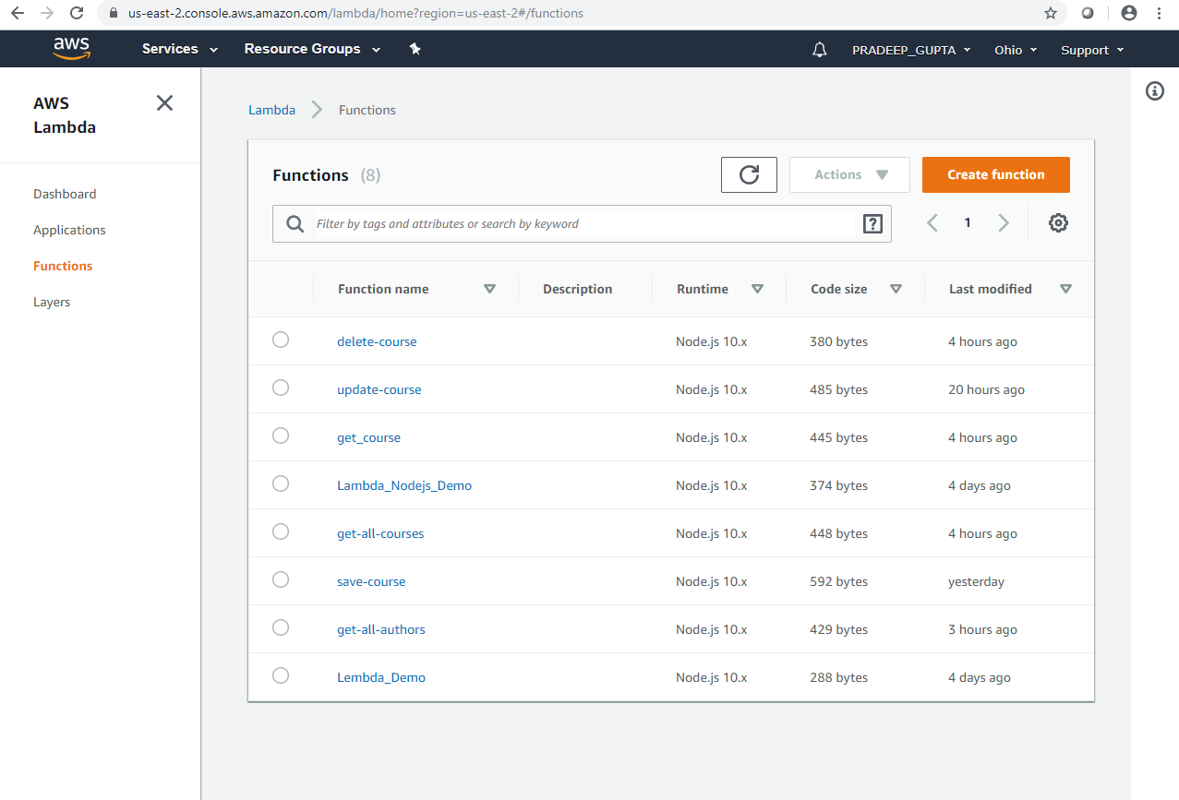
2. Creating Lambda Function – All Lembda Function

Slide 16
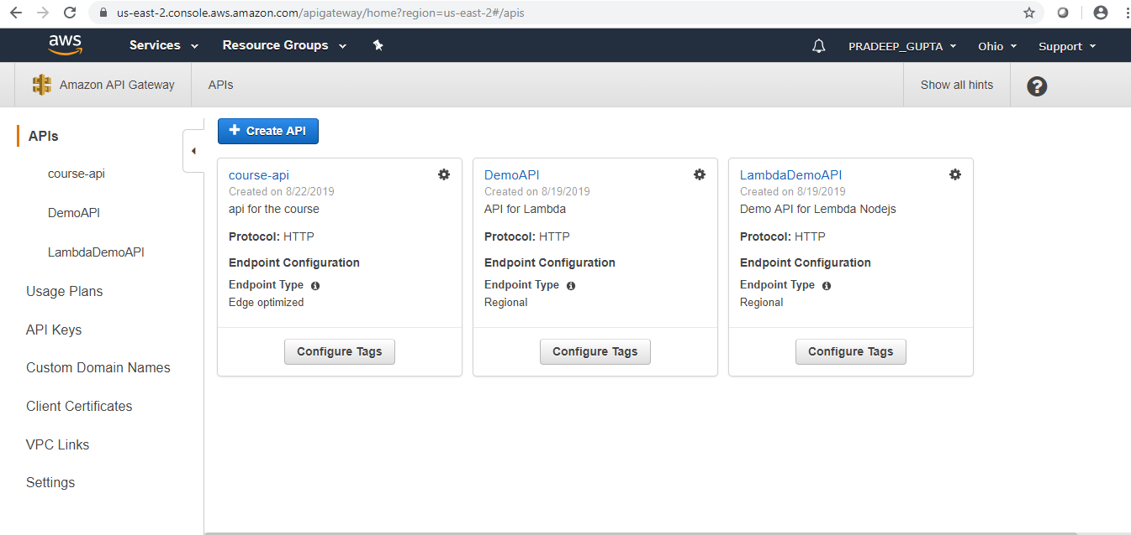
3 – Setting API Gateway

Slide 17
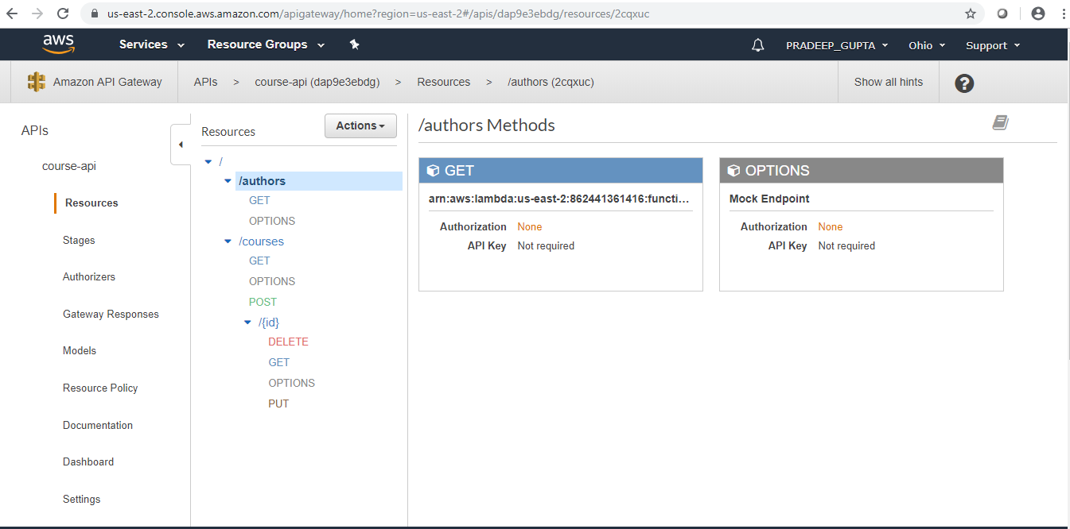
3 – Setting API Gateway
API Name - https://dap9e3ebdg.execute-api.us-east-2.amazonaws.com/v1

Slide 18
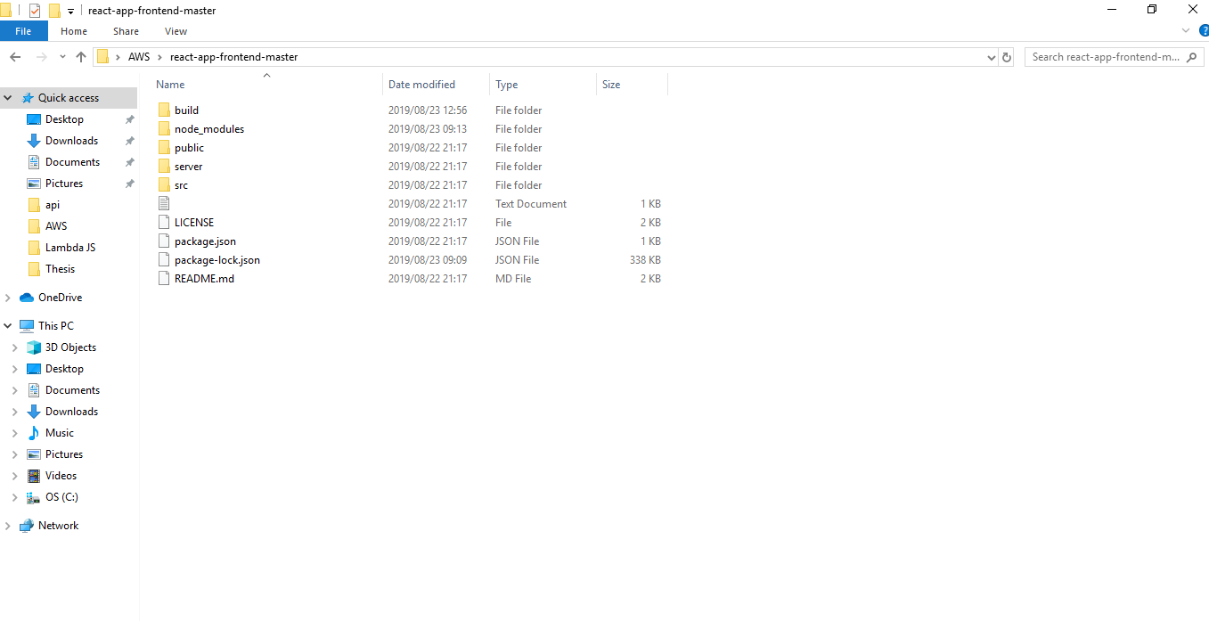
4 – Creating the App

Slide 19
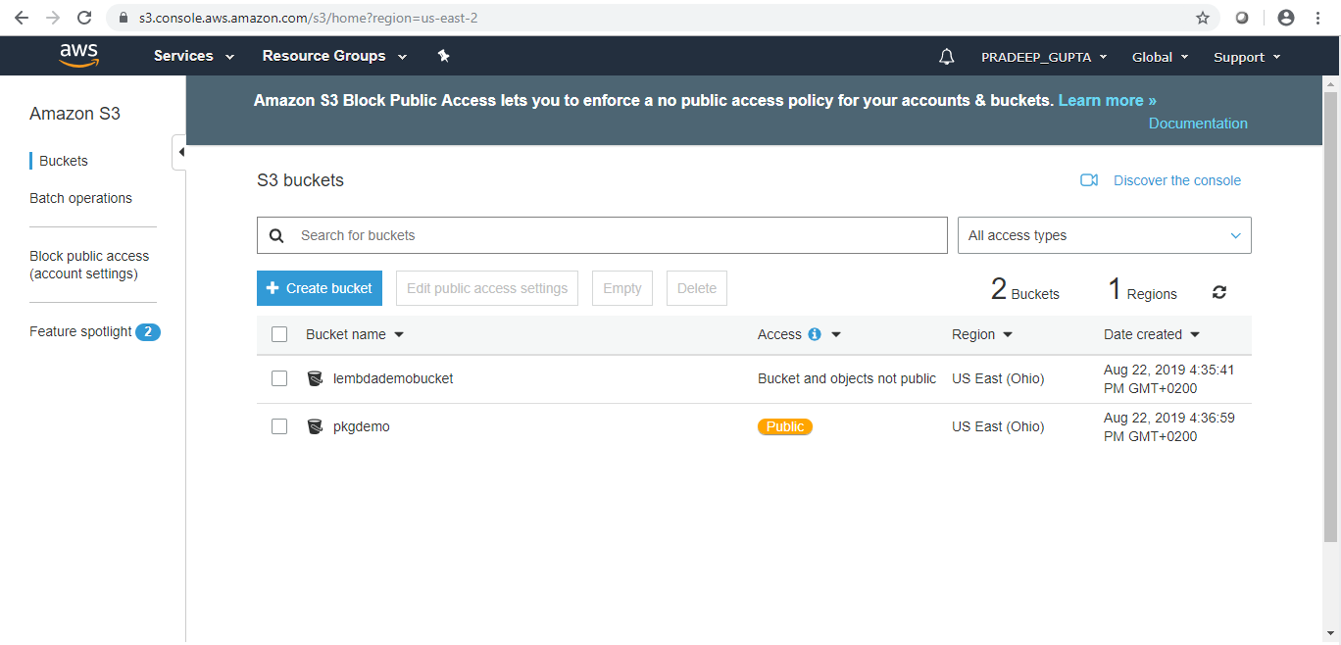
5. Hosting the App in S3

Slide 20
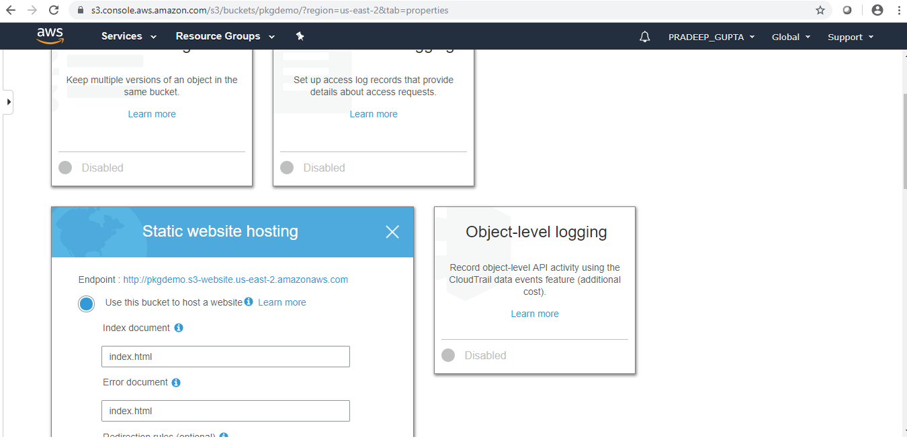
5. Hosting the App in S3

Slide 21
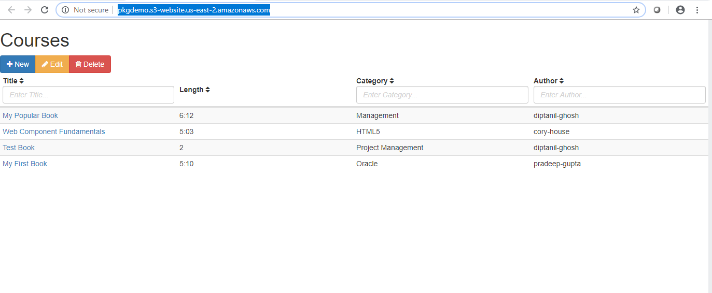
6. Testing a Web App
http://pkgdemo.s3-website.us-east-2.amazonaws.com/

Slide 22
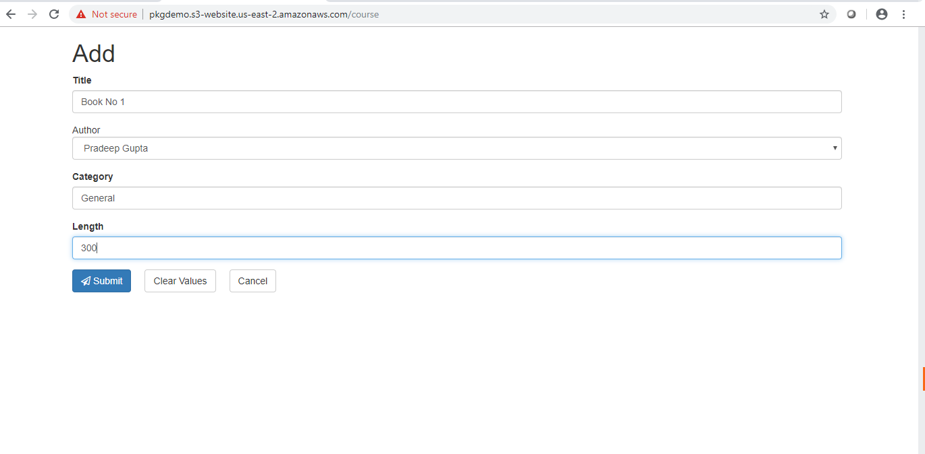
6. Testing a Web App - New
http://pkgdemo.s3-website.us-east-2.amazonaws.com/

Slide 23
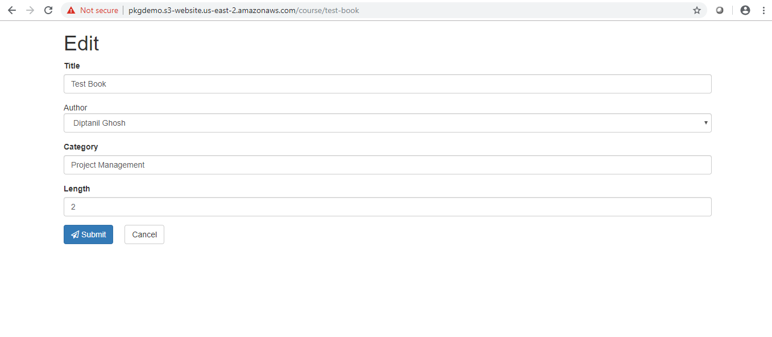
6. Testing a Web App – Edit
http://pkgdemo.s3-website.us-east-2.amazonaws.com/

Slide 24
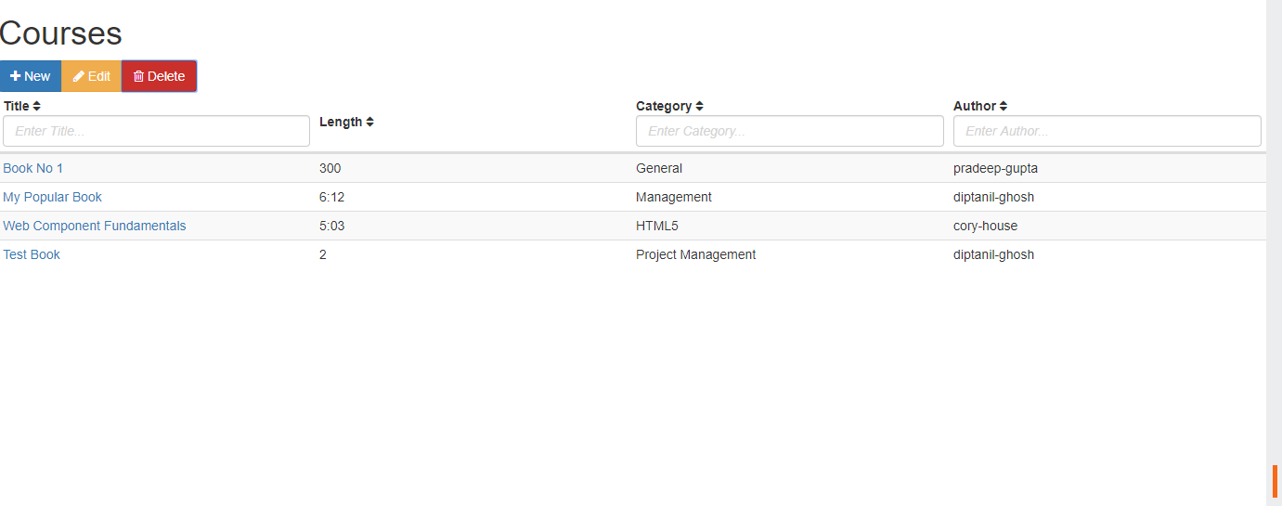
6. Testing a Web App – Delete my first book
http://pkgdemo.s3-website.us-east-2.amazonaws.com/

Slide 25
Thank You

